Slide 1
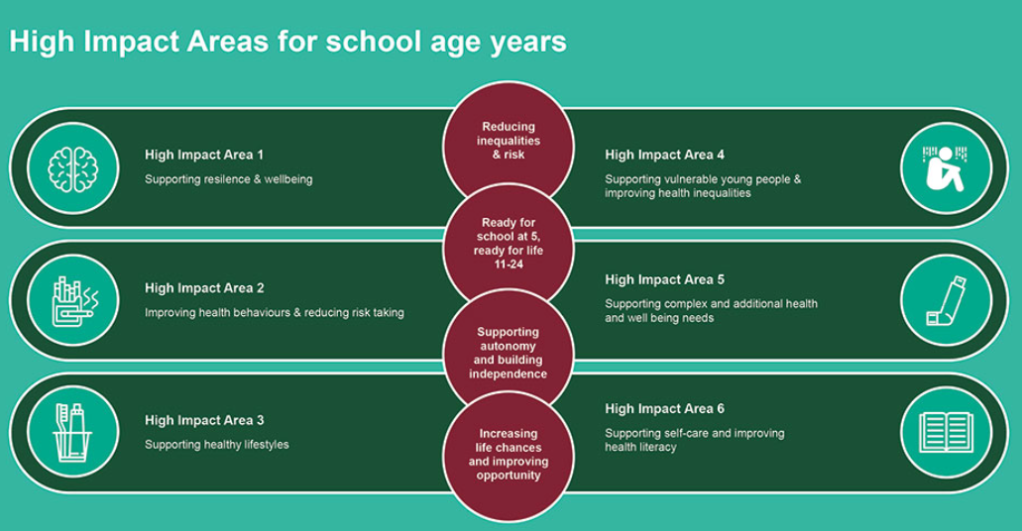
Children and Young People’s Public Health 0-19 service for school age children
We have 10 Localities Pan Dorset and the school nurses now work within our 0-19 skill mix teams in each of these localities.
These place-based skill mixed teams work across the county and across the age range to reflect the requirements and priorities of the new Healthy Child Programme as outlined here.

Slide 2
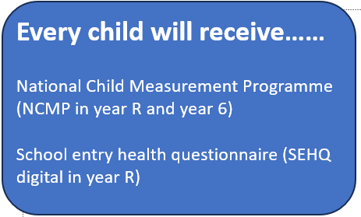
Request for targeted intervention for……
Behaviour Toileting/Enuresis
Relationships Smoking/vaping
Sleep Health eating
Weight management Physical activity advice
Emotional wellbeing support (alongside MHST provision)
**Referrals and signposting to other agencies/services**
Safeguarding……
Part of multi agency safeguarding planning (including CP conferences)
Child protection health needs assessments (for every child under CP planning)

Slide 3
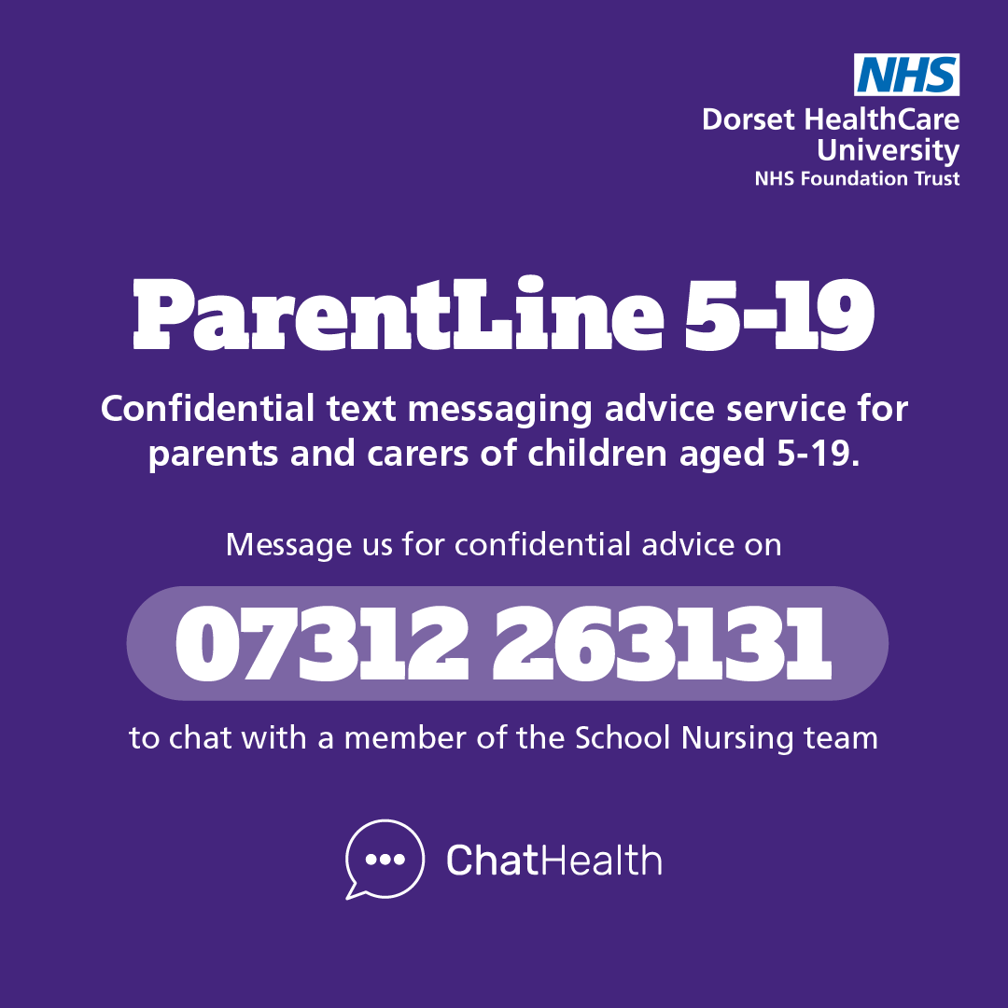
How to contact us
Completion a request for targeted intervention form – School nursing :: Dorset HealthCare University NHS Foundation Trust
Call in to our admin hub - 01929 557558
Or email - dhc.snadmin.hub@nhs.net
ChatHealth (for relaunch Feb 26) text service for 11-19yrs
ParentLine text service for parents.

